Slide 2
PREPARED BY :-
1) BALDANIA MUKESH
2) BHANBHANIA URMESH
3) BARAIYA YOGESH
4) BHALANI HARDIK
5) BHATT VISHAL
6) BHUT KEYUR
7) CHAUHAN PRATAP
8) CHAUHAN VIRAL
9) CHAVDA RAVINA
10) DABHI KALPESH

Slide 3
ELEMENTS OF ELECTRICAL
ENGINEERING
CHAPTER :- 1
ELEMENTRY CONCEPT

Slide 4
INTRODUCTION
IDEAL CIRCUIT ELEMENTS
SOURCE OF ENERGY
OHM’S LAW
TYPES OF NETWORKS
KIRCHHOFF’S LAWS

Slide 5
INTRODUCTION
PROPERTIES
UNIT
EMF V
CURRENT AMP.
POWER WATT
ENERGY JOULE

Slide 6
IDEAL CIRCUIT ELEMENTS
RESISTANCE (R)
CONDUCTANCE
CAPACITOR
INDUCTION

Slide 7
SOURCE OF ENERGY
SOURCE
VOLTAGE SOURCE
CURRENT SOURCE
Independent voltage source
Dependent voltage source
Independent current source
Dependent current source

Slide 8
OHM’S LAW
The ohm’s law state that the ratio of potential difference (V) between any two points and the current flowing between them is constant if temperature remain constant. This ratio is termed as resistance (R)
V/I= constant = R

Slide 9
Resistors connected in a circuit in series or parallel can be simplified using the following:
Series connection
Parallel connection
Notes:
27-1 Resistors in a circuit

Slide 10
Kirchhoff’s voltage law
The Kirchhoff's voltage law (KVL) state that the algebraic sum of the voltage around a closed loop in a circuit must be equal to zero.

Slide 11
Kirchhoff’s current law
It state that the sum of currents directed into any node in a circuit is equal to the sum of the current coming out of the same node.
Σ current entering node n =Σ current coming out of node n
Node n Node n

Slide 12
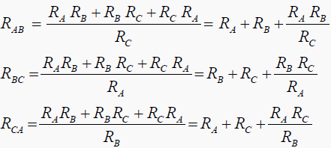
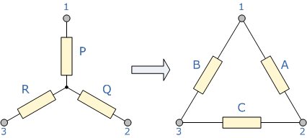
STAR TO DELTA CONVERSATION

Slide 13
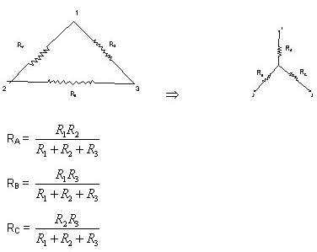
DELTA TO STAR CONVERSATION

Slide 14
PRESENTED BY :-
KEYUR BHUT

Slide 15
Thank You

Slide 16
THE
END

